Slide 1
Write it right

Slide 2
Water

Slide 3
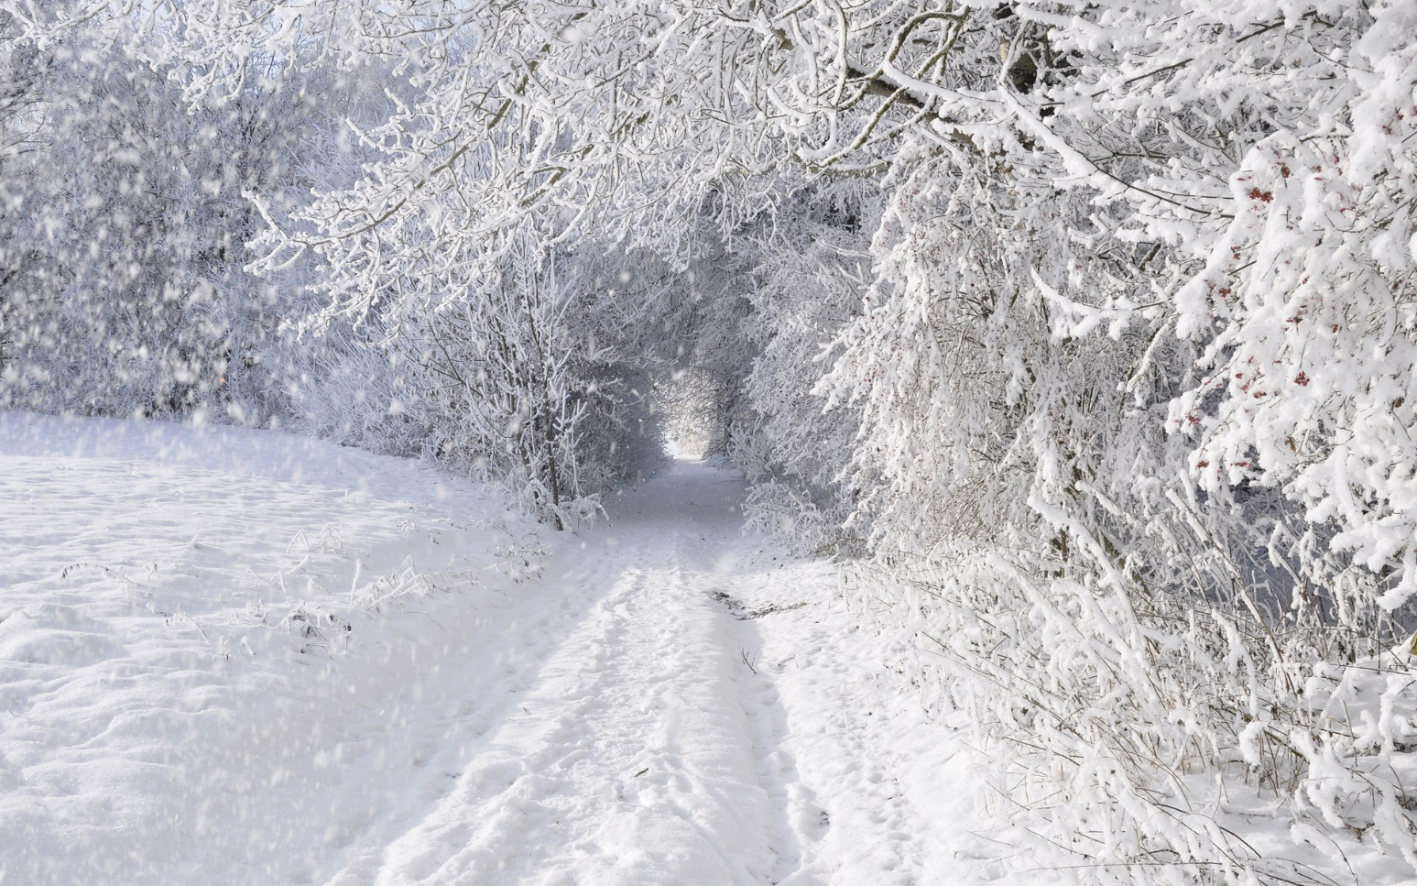
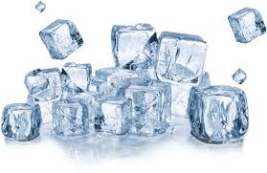
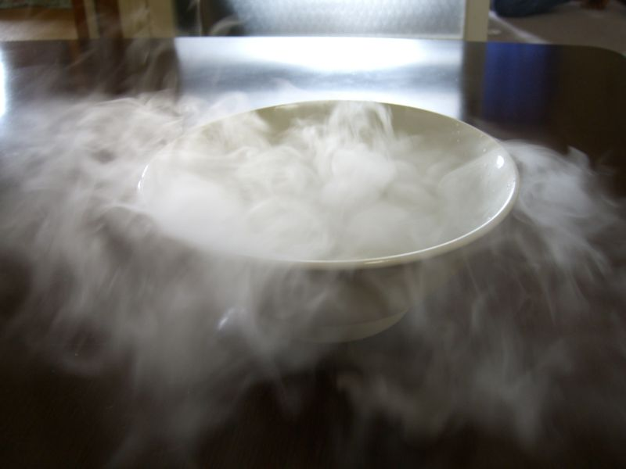
Snow
Rain
Ice
Vapor

Slide 4
What are they???
Water has a lot of properties.

Slide 5
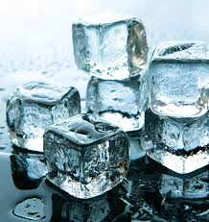
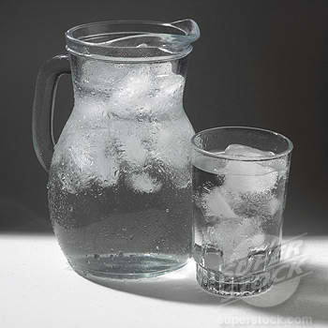
Water
Ice
Frozen water is lighter than water in liquid form
Ice goes up

Slide 6
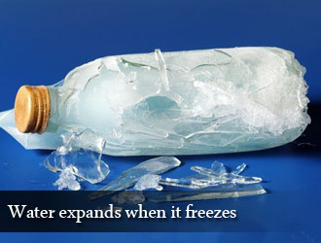
Liquid
water
Frozen
water

Slide 8
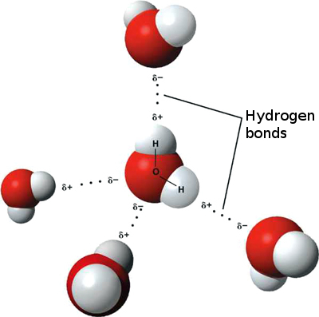
There is strong force of attraction between water molecules

Slide 9
Use the information you’ve just seen to write a short description about water properties. Use conjunctions “if” and “when”.
Start like this:
Like air, water is found almost everywhere. It is familiar to us in different forms, as drinking water, water vapour, ice and snow. Water has surprising qualities. For example, _____________

