Slide 1
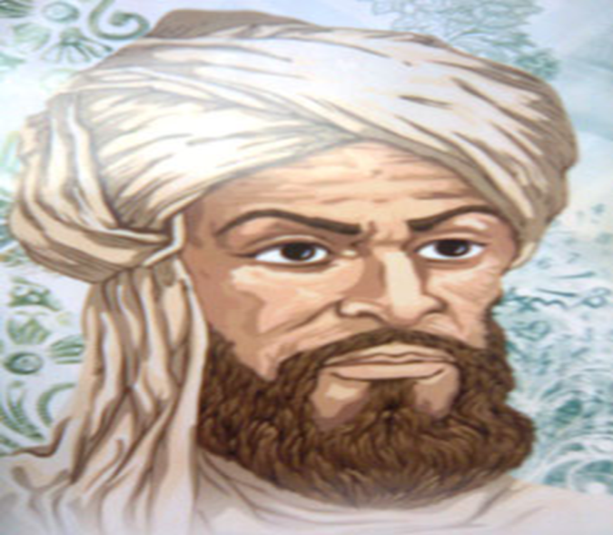
El Khawarizmi
EL Battani
Jaber Iben Hayan
Who are these persons?

Slide 2
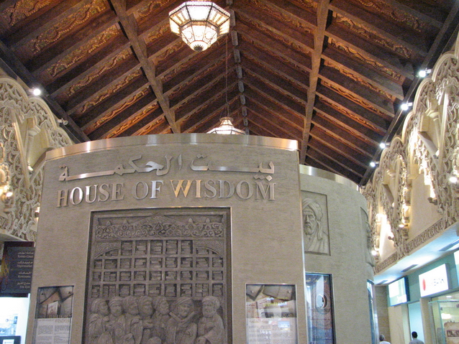
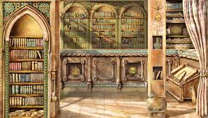
House of wisdom

Slide 3
What do these two scientist do?

Slide 4
Moorish astrolabe 1054 Cordoba

