Slide 1
WEDNESDAY, FEBRUARY 4TH 2015
Sequence : read and consider lesson: reading text: how is your energy balance?

Slide 2
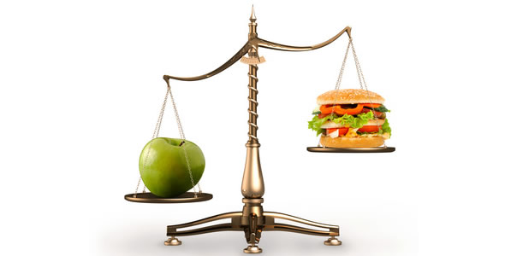
THE TEXT: HOW IS YOUR ENERGY BALANCE?
Activity one : skim through the text and say what each paragraph speak about,
Activity two: taking a closer look p113
Now read the text and mark the statements with true or false

Slide 3
The answers

Slide 4
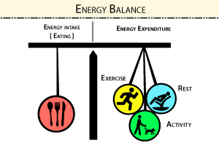
Activity : scan the text to answer these questions
The questions are:
How can we maintain our energy balance?
What are the two (2) possibilities to loose our energy balance?
Why can't people succeed to keep their energy balance nowadays?
What are the junk foods?
Are the consequences of the loss of energy balance negative? JUSTIFY

Slide 5
THE ANSWERS
W e maintain our energy balance when we eat enough food for the exercise we take.
The loss of energy balance can be in two ways:
we eat too little food or the wrong kind of food , we do too much exercise (negative energy balance)
We eat too much food , we do little exercise ( positive energy balance)
3.People do not succeed to keep their energy balance because of the many advertisement on unhealthy food
4.Junk food contains large amount of fat and sugar
5.YES, the consequence of the loss of energy balance are negative .

Slide 6
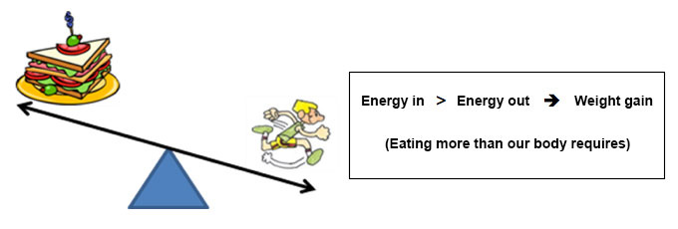
negative energy balance

Slide 7
positive energy balance

